Slide 1
Play this slideshow from beginning
KS2 WATER SAFETY canals and rivers
HOME LEARNING
© PSHE Association 2021

Slide 2
We are learning about keeping safe near rivers, canals, lakes and reservoirs
We will be able to:
identify hazards and hidden dangers near canals and rivers
explain how to keep safe near canals and rivers
describe what to do if there is an incident or emergency
© PSHE Association 2021

Slide 3
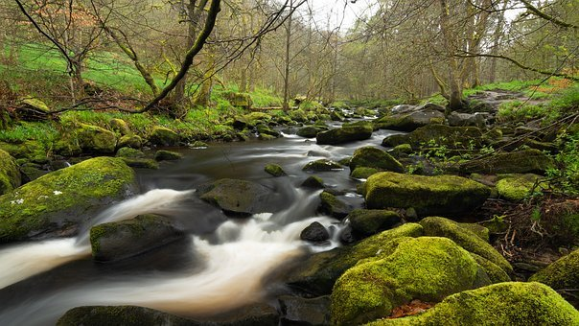
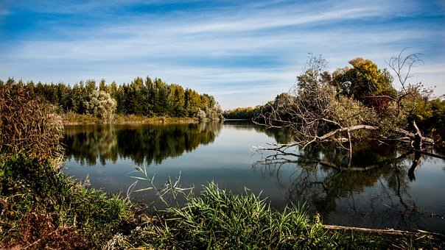
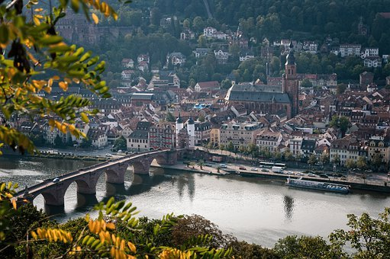
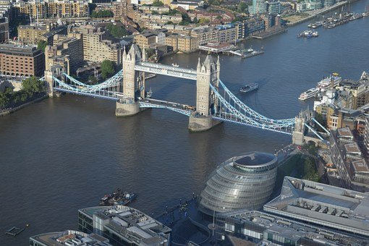
Rivers
Rivers are waterways that are formed by nature. They can be found in rural areas, towns and cities.
© PSHE Association 2021

Slide 4
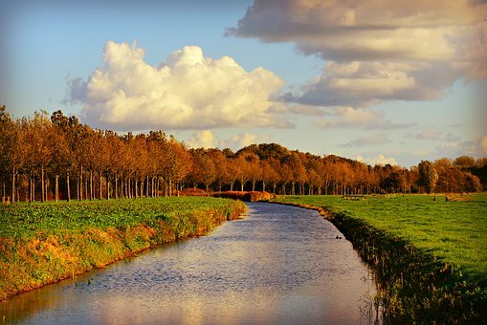
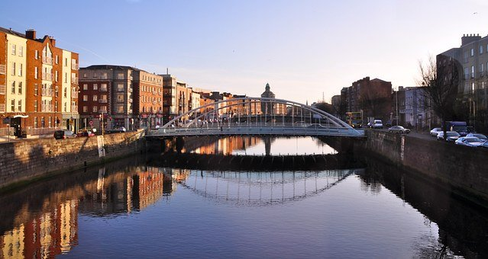
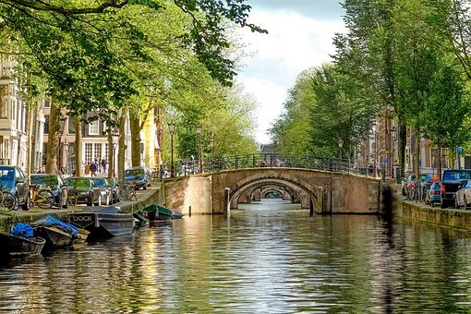
Canals
Canals are waterways that are made by people. They can be found in the countryside, towns and cities.
© PSHE Association 2021

Slide 5
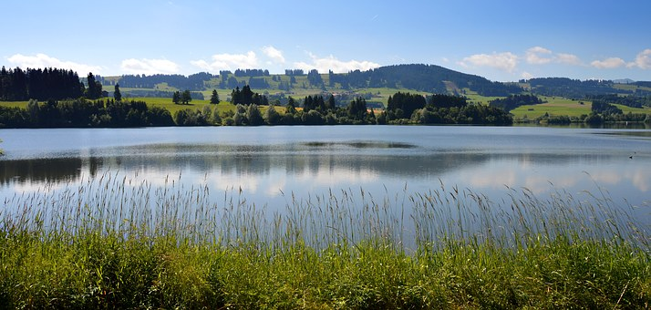
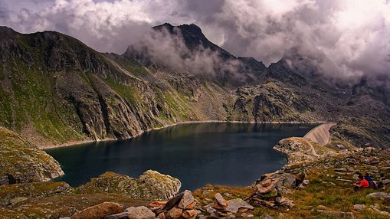
Lakes and reservoirs
A lake is a large area of water surrounded by land.
A reservoir is a natural or artificial lake used as a water supply.
© PSHE Association 2021

Slide 6
What’s our starting point?
Draw and write
What can children do to keep safe near canals, rivers, lakes and reservoirs?

Slide 7
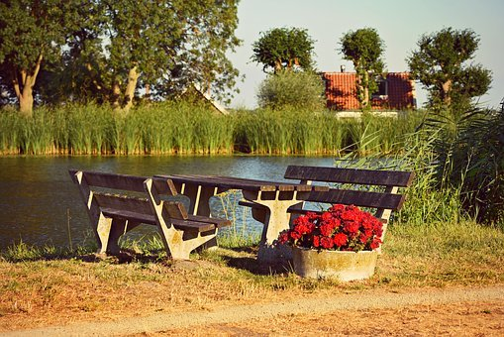
Rivers and canals, lakes and reservoirs
Why do people like visiting these places?
What activities might people do here?
Think of 5 ideas…
© PSHE Association 2021

Slide 8
Activities
Here are some ideas…
Quiet-time
Boats / canoeing
Fresh air
Relaxation
Sports
Fun
Fishing
Wildlife
Walking
Picnics
Visiting new places
Days out / holidays
Time with friends or family
© PSHE Association 2021

Slide 9
Keeping safe near lakes, rivers and canals
It is fun to visit lakes, rivers and canals, but it is important to keep safe.
There are lots of hazards and some might be ‘hidden’ dangers. That means we may not see them immediately or at all, but they may still be there.
Look carefully at the picture on the next slide. Find at least 5, up to 10 hazards.
Some are hidden dangers.
© PSHE Association 2021

Slide 11
Did you find all the possible dangers?
1.
10..
4.
3.
9.
2.
5.
7.
8.
6.

Slide 12
List of hazards and dangers (1-5)
Rocks might be slippery, someone could slip/fall in the water.
Playing too close to the water, someone might fall in.
Swinging on the tree, the branch might break, the person could fall.
Water may not be treated or be polluted, this is not safe for swimming.
Life-ring has been broken from it’s stand and is floating in the water. If someone needs it, it won’t be there.
© PSHE Association 2021

Slide 13
List of hazards and dangers (6-10)
The young child is wandering off alone near water, they may fall in.
Kneeling too close to the edge of the water means someone could slip into the water (reeds and vegetation can hide the edge).
Balancing on the bridge is dangerous, someone might fall.
Fishing rods and lines can be hazards, someone could trip over them.
Fast-running water and currents, unseen rocks, deep or very cold water means rivers are usually not safe for swimming.
© PSHE Association 2021

Slide 14
What to do in an emergency.
Even when we take care, sometimes accidents do happen. It is important to know what to do if an accident occurs.
Imagine there has been an accident and Kris has fallen in the water. His friends are playing nearby.
What should Kris do?
What should his friends do?
© PSHE Association 2021

Slide 15
Can you help Kris?
Choose the statements that will help Kris.
Then reveal the answers, by clicking on the boxes.
Float on his back, face-up
Try to float then stand up
No, the water may not be clear.
Dive underneath the water
Shout ‘help’
Yes, to attract attention
Try to swim to the edge
Yes, hold on to something
Jump around and splash in the water
No, this will be too tiring
© PSHE Association 2021

Slide 16
What should Kris’s friends do?
Choose the correct statements.
Then reveal the answers, by clicking on the boxes.
Jump in the water to help
No, this is not safe
Reach out to Kris
No, they might fall in too
Tell Kris to ‘try to keep calm’
Yes, reassure Kris
Find an adult to help
Yes, an adult is needed
Look for something to help Kris float
Yes, like a ball or an empty plastic bottle
© PSHE Association 2021

Slide 17
Waterways safety quiz
There are six questions to answer on the next slides.
Do you know how to keep safe by rivers and canals, lakes and reservoirs?
Test yourself by completing the quiz.
© PSHE Association 2021

Slide 18
Question 1.
Beth wants to go for a walk by the canal. Should Beth…
go by herself so she can be nice and quiet?
go with a friend?
wait for her dad to take her?
© PSHE Association 2021

Slide 19
Answer 1.
Answer c:
Beth should wait for her dad to take her.
Visiting rivers, canals, lakes and reservoirs is a really fun and nice thing to do, but accidents can happen so people should not go alone, children should always visit with an adult.
© PSHE Association 2021

Slide 20
Question 2.
Stefan’s football has rolled into the river. Should he…
make a lasso with rope to pull it back?
step slowly into the river to see how deep it is before reaching for the ball?
leave it and tell a trusted adult?
© PSHE Association 2021

Slide 21
Answer 2.
Answer a:
Stephan should leave it and tell a trusted adult.
It may not be safe to go close to the water to reach the ball, an adult will be able to help.
© PSHE Association 2021

Slide 22
Question 3.
It is a hot and sunny day, Rae wants to swim in the lake but
which of these might be hidden dangers?
The water depth
Slippery banks and edges
Polluted or untreated water
© PSHE Association 2021

Slide 23
Answer 3.
Answer a, b and c:
The water depth
Slippery banks and edges
Polluted or untreated water
All of these could be hidden dangers if swimming in a lake, river or canal.
© PSHE Association 2021

Slide 24
Question 4.
What does this sign mean?
No front crawl
No swimming
It is safe to swim here
© PSHE Association 2021

Slide 25
Answer 4.
Answer b:
No swimming.
This sign means it is not safe to swim here.
It can be dangerous to swim in rivers and canals, as there may be unseen or unexpected hazards such as:
fast-running water
unseen rocks or objects in the water (broken glass, litter)
unpredictable currents
slippery banks and edges
deep water or cold water
© PSHE Association 2021

Slide 26
Question 5.
Devi sees that someone has fallen into the river and is in distress. Should Devi…
encourage them to try to float then swim to the side?
give them a bar of chocolate for energy?
dive in to help them?
© PSHE Association 2021

Slide 27
Answer 5.
Answer a:
Devi should encourage them to try to float then swim to the side.
Only adults who are trained should enter the water to rescue a person in distress.
© PSHE Association 2021

Slide 28
Question 6.
Someone has fallen into the canal and cannot swim. Yinka and her friends are playing football nearby. Should they…
lie by the side of the canal and try to reach out to the person?
throw the person the football?
find a long stick to help reach the person from the bridge?
© PSHE Association 2021

Slide 29
Answer 6.
Answer b:
Devi and her friends should throw the person the football.
The person can hold on to the football to help them float.
The other options are not safe.
© PSHE Association 2021

Slide 30
Well done…
You completed the quiz!
How many did you get right?
? out of 6.
© PSHE Association 2021

Slide 31
What do you think our safety message is?
Which word does
each letter stand for?
Think about lakes, rivers and canals.
© PSHE Association 2021

Slide 32
From the…
Stay…
Away…
Edge…
© PSHE Association 2021

Slide 33
© PSHE Association 2021

Slide 34
Remember…
Children should always tell an adult where they are going.
Children should stay with an adult near water.
Be aware of hazards near waterways.
Always tell an adult if you think someone is in danger.
In an emergency, call 999. Describe where you are as accurately as possible.
© PSHE Association 2021

Slide 35
Keeping safe near canals and rivers
Where are we now?
Well done on completing the activities!
Now go back to the ‘What’s your starting point?’ activity.
Draw or write what children can do to keep safe near canals, rivers, lakes and reservoirs.
Is there anything you would like to change?
Is there anything you would like to add?
© PSHE Association 2021

Slide 36
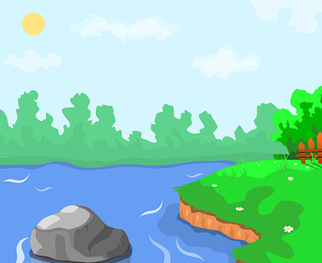
Additional activity
Write six safety rules for keeping safe near rivers, canals, lakes or reservoirs, then design these into a poster.
You could start the sentences…
Do…
Don’t…
© PSHE Association 2021

