Slide 1
KS1 Health and wellbeing: Keeping safe
Parents: read our helpful guidance before you start.
HOME LEARNING
Household products
Play this slideshow from beginning
(or press ‘F5’).
© PSHE Association 2021

Slide 2
KS1 Health and wellbeing: Keeping safe
HOME LEARNING
Household products
© PSHE Association 2021

Slide 3
We are learning about keeping safe around household products.
We will be able to:
identify how we know if something might be harmful to bodies
state some safety rules for the safe use of household products
recognise risk in situations related to household products
suggest basic strategies to respond to risk involving household products
identify when we should ask an adult for help
© PSHE Association 2021

Slide 4
What is our starting point?
Questions
Look at the products in the picture. These are all things we might see at home.
Answer these questions:
Where are they kept?
What are they used for?
Who uses them?
How are they used safely?
© PSHE Association 2021

Slide 5
Hazard labels
Have you seen symbols like these at home?
Where might you see them?
© PSHE Association 2021

Slide 6
Hazard labels
You might find hazard labels on decorating, craft,
cleaning, medicine or hygiene products like these…
© PSHE Association 2021

Slide 7
Hazard labels
What do the symbols mean?
Match the correct symbol to the label.
Then check your answers on the next slide.
Catches fire easily.
Very dangerous if used near fire.
Warning! Can cause harm to bodies.
Toxic to fish and ponds.
Dangerous for wildlife.
© PSHE Association 2021

Slide 8
Hazard labels — answers
When you see a hazard triangle is usually means something can be harmful.
Take extra care!
Catches fire easily. Very dangerous if used near fire.
Warning! Can cause harm to bodies.
Toxic to fish and ponds.
Dangerous for wildlife.
© PSHE Association 2021

Slide 9
Safety labels
What are the safety instructions these labels show?
Think first, then click on the boxes to reveal the answers.
Keep out of children’s reach.
If any goes in the eyes, rinse with water.
Wash hands after use.
Not suitable for children under three years old.
© PSHE Association 2021

Slide 10
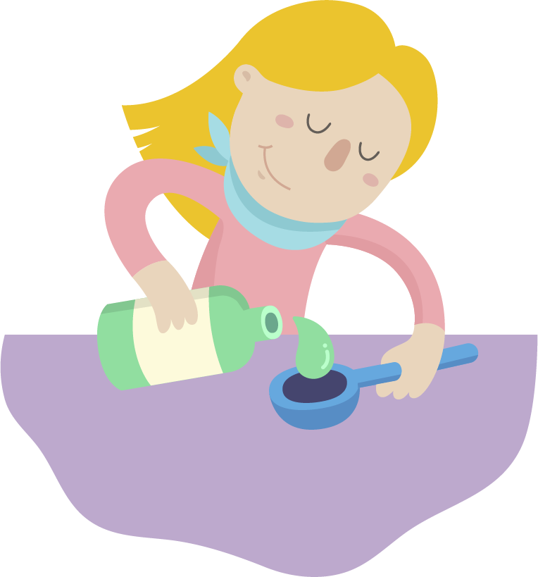
Keeping safe at home
Not all products have labels or symbols, so we must be careful when using different things in the home.
Most products have written instructions explaining how to use them safely.
Some things are for adult use only.
© PSHE Association 2021

Slide 11
Safety rules
Never put something in your mouth or onto your skin if you do not know what it is.
Children should not use medicines or cleaning products without asking an adult first.
If a substance might be harmful to bodies, it should be stored away from children’s reach.
Adults should wear gloves when handling some household substances to protect their skin.
© PSHE Association 2021

Slide 12
Safety rules scenarios
Put your understanding of safety rules to the test!
Then click on the purple button to reveal whether the action is correct.
On the next slides there are six scenarios.
Read each scenario and help the character choose the best thing to do.
There may be more than one correct answer.
A.
B.
C.
© PSHE Association 2021

Slide 13
Safety rules scenario 1
Sam is not sure what this is. Sam wonders if it is safe to open it.
What should Sam do?
A. Walk away. This is not safe for children.
B. Ask a trusted adult.
C. Open it. Smell it.
© PSHE Association 2021

Slide 14
Safety rules scenario 2
“Ooh they look like sweets — I’d like to eat those!” thinks Billie.
What should Billie do?
A. Eat them.
B. Ask a trusted adult.
C. Not touch them. They may not be sweets.
© PSHE Association 2021

Slide 15
Safety rules scenario 3
Sky has seen a pot of cream in the bathroom. She thinks it will make her skin soft.
What should Sky do?
A. Ask a trusted adult.
B. Put it on her hands.
C. Put it on her face and body.
© PSHE Association 2021

Slide 16
Safety rules scenario 4
Baby Kai is playing with bottles from the kitchen cupboard. Eli walks in.
What should Eli do?
A. Join in and play with Kai.
B. Tell an adult.
C. Move Kai away from the bottles.
© PSHE Association 2021

Slide 17
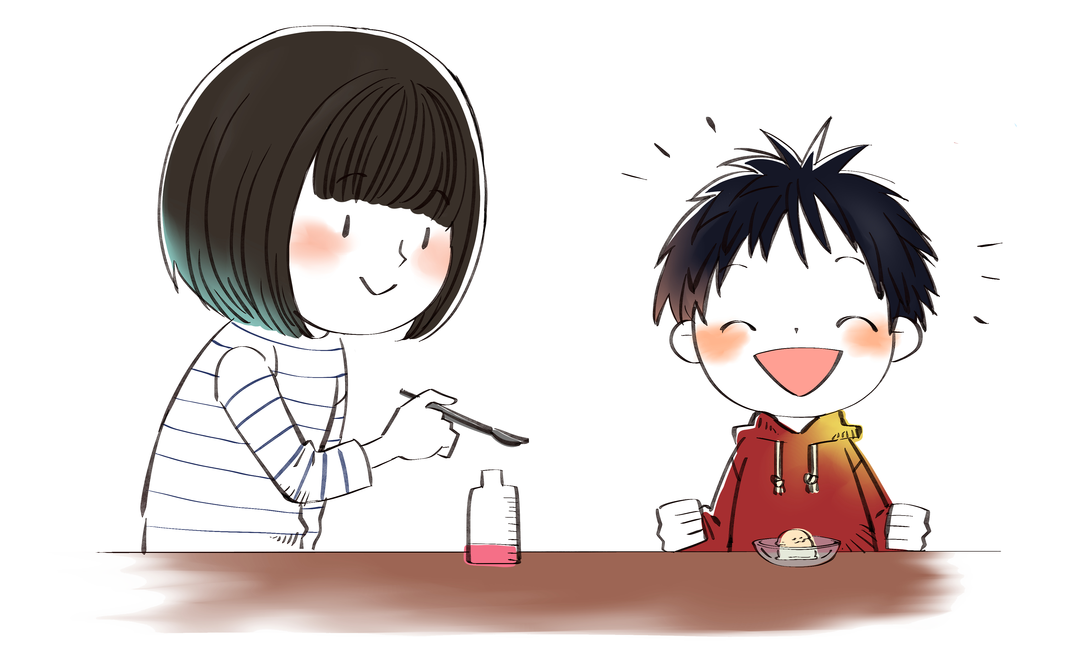
Safety rules scenario 5
“Let’s share this medicine. It tastes like strawberries!” says Ling.
What should the children do?
A. Taste the medicine.
B. Drink the medicine.
C. Not touch the medicine.
© PSHE Association 2021

Slide 18
Safety rules scenario 6
Amrit has knocked over a can of black sticky liquid in the shed. It has spilt on the floor.
What should Amrit do?
A. Clean it up.
B. Tell an adult.
C. Leave it and walk away.
© PSHE Association 2021

Slide 19
Asking for help
It is important to ask a trusted adult before touching things at home, especially if you don’t know what they are.
If there is an emergency. For example, if someone has swallowed something that might be dangerous, tell an adult quickly.
If the adult needs help, or there is no adult nearby, dial 999 on a phone and ask for an ambulance. They will ask you questions, such as where you are and they will send help.
© PSHE Association 2021

Slide 20
Keeping safe — household products
Where are we now?
Well done on completing the activities!
Now think about what you have learned by writing and finishing these sentences.
Always…
You should never…
It is important to…
© PSHE Association 2021

Slide 21
Additional activity
Look out for safety labels at home.
Ask a trusted adult to help you find labels on household products and find out what they mean.
Make sure you only do this with an adult’s help.
Do not use the internet without adult supervision.
Choose one item and draw or write about who should use it (adults or children) and how to use it safely.

