Slide 1
Before you get started
Parents: read our helpful guidance before you get started
Assessing Risk
HOME LEARNING LESSON
To start, play this slideshow from beginning (F5)

Slide 2
Parents and teachers: Home learning about risk
When learning about risk, it is important to use examples and explanations which are not instructional or inspiring in the very behaviours we are aiming to reduce. This has been shown to be counterproductive.
For example, avoid talking about how risky it might be to drink to excess by describing an entertaining or extreme cautionary tale.

Slide 3
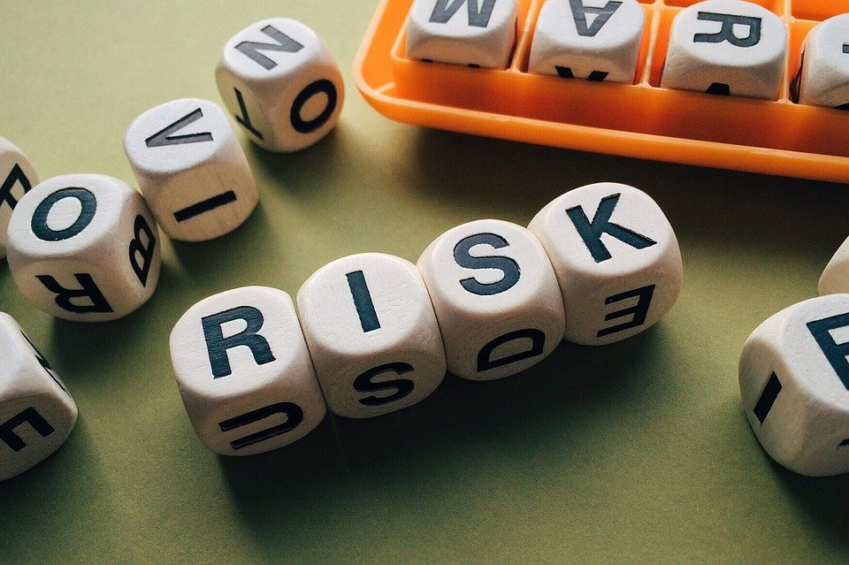
HOME LEARNING
Assessing Risk, KS3

Slide 4
We are learning about how to assess and manage risk
We will be able to:
explain the factors which affect the level of risk in different situations
suggest strategies for assessing and managing risk

Slide 5
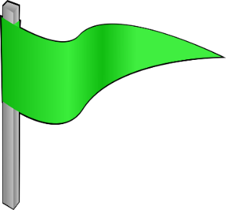
Assessing risk
Create a continuum from low to high-risk behaviours
There is no definitive answer so it’s important to be able to justify your choices.
1. Horse-riding lessons | 2. Cycling without a helmet | 3. Learning a new hobby
4. Starting a business | 5. Stealing from a shop | 6. Drinking energy drinks daily
7. Learning to drive | 8. Going for a job interview | 9. Crossing the road
Key question:
How did you decide what was more risky and what was less risky?
Copy this continuum line to start!
Low risk
High risk

Slide 6
Assessing risk
When you were deciding the level of risk in those scenarios, you probably reflected on:
Potential level of harm
Likelihood of harm
Safety measures to reduce potential harm
The potential pay-offs — things a person would gain
Each person will use their opinions and past experiences to assess risk.
Research evidence can help us too.

Slide 7
Assessing risk — let’s compare
Focus on these two examples to explore how to assess risk and minimise potential harm. Create two tables like the example and complete them using your own knowledge. Then read the next slides for more information.
Drinking daily energy drinks
Learning a new hobby
Potential risks | Likelihood of harm
Safety measures | Potential pay-offs
Potential risks | Likelihood of harm
Safety measures | Potential pay-offs

Slide 8
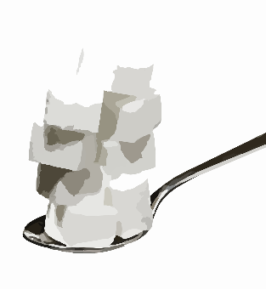
Assessing risks: energy drinks
What are the risks of energy drinks?
Effects may include: anxiety, sleep issues, headaches, stomach upset
Can also lead to heart palpitations
What are the risks of continued use?
Regular use can impact behaviour and mood and can affect school and sports performance
There are up to 21 teaspoons of sugar in an energy drink which increases health risks such as obesity, dental health issues, acne and type 2 diabetes
Potential risks | Likelihood of harm
Safety measures | Potential pay-offs
From age 11, maximum recommended sugar intake per day is 30g (7 teaspoons)
Notes:
Based on current scientific opinions on the safety of caffeine, children and young people are advised to only consume caffeine in moderation. For a 10-year-old child weighing 30kg, this would work out to around 90mg of caffeine, which is approximately the equivalent of one 250ml can of energy drink, or two to three cans of cola, or a mug of instant coffee. This is the maximum a young person should consume and is not a recommendation.
Caffeine carries fewer legal restrictions than other drugs, although supermarkets have banned the sale of energy drinks to children under 16 and the government has proposed introducing a legal ban. Some medicines which contain caffeine may only be available on a doctor's prescription.

Slide 9
Assessing risks: energy drinks
What is the likelihood of harm
Each person responds differently to substances and those with underlying health conditions may be more affected.
Energy drinks contain caffeine and sugar which are potentially habit-forming substances.
Risks increase with regular or high level usage.
Potential risks | Likelihood of harm
Safety measures | Potential pay-offs
Are there any safety measures?
All food or drink products are quality assured and tested to check for contaminants.
Different energy drinks contain different levels of key substances — careful selection can reduce the likelihood of harm.

Slide 10
Assessing risks: energy drinks
What are the potential pay-offs for taking the risks to health from energy drinks?
People may enjoy the taste.
Some people find they feel a temporary energy boost but this is often followed by feeling drowsy and lazy.
Potential risks | Likelihood of harm
Safety measures | Potential pay-offs
Reflection
Take time to reflect on what you’ve learnt about energy drinks, and how to assess risk before continuing!

Slide 11
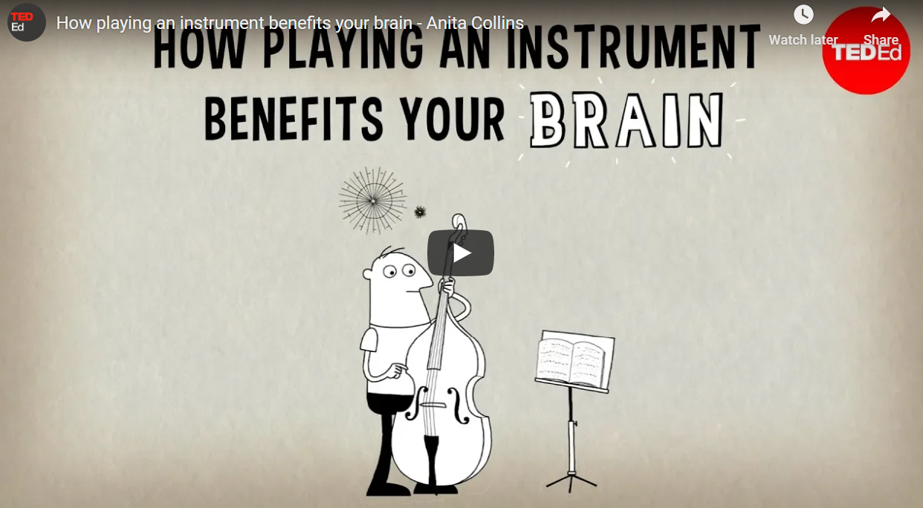
Assessing risks: learning a new hobby
Consider the mental, physical and social benefits of starting a new hobby, along with any potential downsides relating to feelings and practical complications.
These video clips provide optional inspiration to help you complete your table.
Click on the icons to watch.
Learning an instrument
Benefits of outside interests
Notes:
How learning an instrument benefits your brain - https://www.youtube.com/watch?v=R0JKCYZ8hng&feature=emb_logo (4.45 minutes)
Zuckerberg: Having a hobby can make you better at your job –
https://www.cnbc.com/video/2017/03/13/zuckerberg-having-a-hobby-can-make-you-better-at-your-job.html?jwsource=cl (0.55 minutes)

Slide 12
Assessing risks: learning a new hobby
You may have had these key ideas:
What are the risks involved?
Challenges can lead to disappointment
May not enjoy the experience
May be financial costs involved
Potential risks | Likelihood of harm
Safety measures | Potential pay-offs
What is the likelihood of harm?
With the exception of some riskier hobbies (e.g. extreme sports), there are limited harms.
What about safety measures?
Each hobby will have different things to consider — some sports require protective equipment, some creative pursuits require chemicals or hot tools which can be used safely if tuition and/or supervision are provided.
Notes:
https://www.choosingwisdom.org/pick-new-hobby/
https://youtu.be/fy4qvxZHxC8 - Why an Entrepreneur - Mallory Brown Career Girls Role Model (0.37 minutes)
https://youtu.be/TFR_1qPK3pI – The Guardian Lab My biggest business mistake: entrepreneurs confess (1.42 minutes)

Slide 13
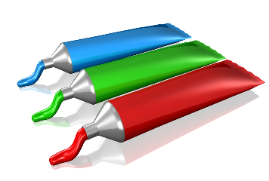
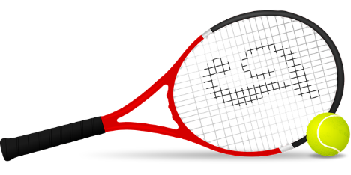
Assessing risks: learning a new hobby
You may have had these key ideas:
What are the potential pay-offs involved?
Research suggests that creative hobbies and sports can improve mental and physical health. One study found that even less physically active hobbies can improve physical health.
Research also suggests we are likely to think more positively and creatively if we engage in creative interests.
Hobbies can lead to additional career options.
Social and enjoyment aspects of new hobbies can provide further quality of life benefits.
Potential risks | Likelihood of harm
Safety measures | Potential pay-offs

Slide 14
Assessing risk: Reflection
Note down your reflections from this activity by answering these questions.
What did this activity tell you about risk?
How can we decide if a risk is worth taking or not?
What can reduce the risks in a situation?
© PSHE Association 2021

Slide 15
Assessing risk: Reflection
Key ideas you may have thought about:
Risk is a part of life so we need to learn to assess risks that are and are not worth taking.
Our ‘gut reaction’ often tells us useful information about whether a risk is worth taking or not.
The greater the risk of harm, the less likely it is that it is worth taking the risk, whatever the pay-off.
Sometimes we can reduce risks by thinking ahead about any safety measures we can put in place.
© PSHE Association 2021

Slide 16
What advice could we give Ty?
Note down the advice a good friend would give Ty to help him decide what to do in this situation.
Ty is bored during lockdown so is excited when a friend challenges him to a dare. But then a feeling in the pit of his stomach tells him it might not be such a good idea.
Right now it is normal to crave something exciting but risky dares are not the way to improve mood or relieve boredom.
The feeling Ty described is our internal ‘warning sign’ that reminds us to stop and assess the risks.
Temporary relief from boredom is never worth risking injury through dares and challenges.
Click on the text box to reveal some hints: Does your advice include some of these key points?
Notes:
Right now it is normal to crave something exciting but risky dares are not the way to improve mood or relieve boredom.
The feeling Ty described is our internal ‘warning sign’ that reminds us to stop and assess the risks.
Temporary relief from boredom is never worth risking injury through dares and challenges.

Slide 17
Five top tips
To finish off, write down 5 top tips for people needing to manage risk in a situation.
© PSHE Association 2021

Slide 18
Five top tips
Did you include some of these tips?
Think before acting
Slow down to give yourself time to think
Find ways to reduce risks if the activity is valuable
Get advice if you need it
Be wary of focusing too much on the pay-off and not the risks
Support friends taking positive risks
Listen to your gut feeling if something doesn’t feel right
Support friends by not encouraging them to take unnecessary risks
© PSHE Association 2021

Slide 19
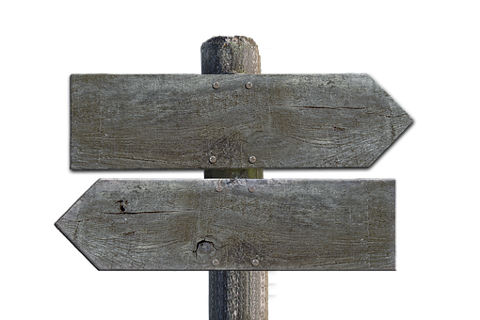
Remember!
If you are worried about anything from today’s session, talking to an adult you trust is one of the best ways to find help. Alternatively, ChildLine can help.
Talk to a trusted adult
ChildLine: www.childline.org.uk
0800 1111

Slide 20
More activities
Design a poster to explain how important it is to stop and think before taking a risk.

